Slide 1
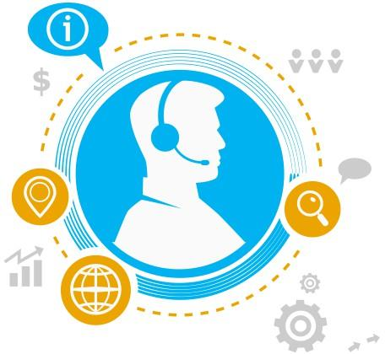



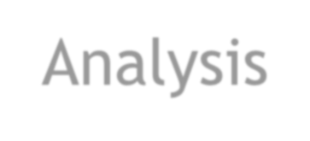
Spreadsheet Project:
IT Ticket Analysis
Presented by : Shashwat Shankar

Slide 2
Problem Statement
The objective is to analyze the IT support ticket management system to understand the performance of IT agents, the efficiency of ticket resolution, and the satisfaction levels of employees. The analysis aims to identify high and low performers among IT agents, assess the overall effectiveness of the team, and pinpoint areas for improvement in the ticket resolution process. The ultimate goal is to make informed staffing decisions, including hiring, firing, and training, to enhance overall service quality and team performance.

Slide 3
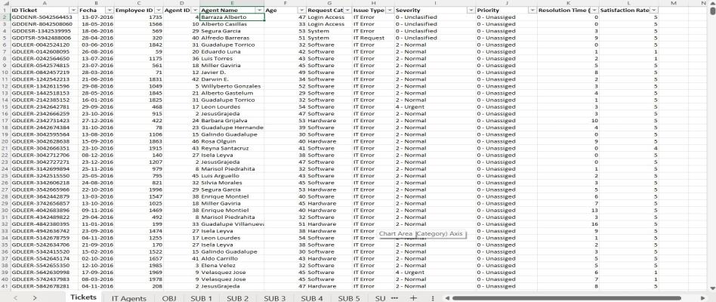

Tickets Sheet Data

Slide 4
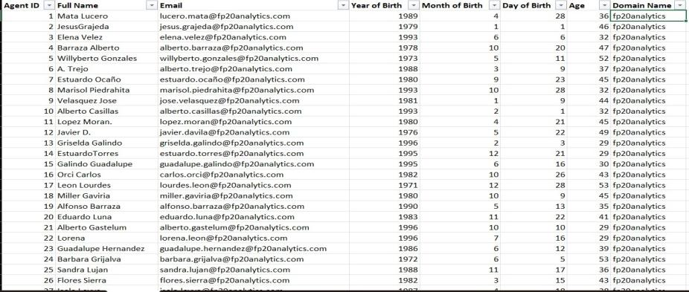

IT Agents Sheet Data

Slide 5
Data Attributes
▶ Tickets Sheet: Contains information about IT support tickets.
IT Agents: Contains information about IT agents.
▶ ID Ticket: Unique identifier for the ticket.
▶ Fecha: Date of the ticket.
▶ Employee ID: ID of the employee who raised the ticket.
▶ Agent ID: ID of the agent assigned to the
ticket.
▶ Request Category: Category of the request (e.g., Login Access, System, Software).
▶ Issue Type: Type of issue (e.g., IT Error, IT Request).
▶ Severity: Severity of the issue.
▶ Priority: Priority level of the issue.
▶ Resolution Time (Days): Time taken to resolve the ticket.
▶ Satisfaction Rate: Satisfaction rate
provided by the employee (1-5 scale).
Agent ID: Unique identifier for the agent.
Full Name: Full name of the agent.
Email: Email address of the agent.
Year of Birth: Year the agent
was born.
Month of Birth: Month the agent was born.
Day of Birth: Day the agent was born.

Slide 6

Methodology
Data Collection
  Collected raw IT support data in Excel format.
  Verified structure, data types, and column consistency.
Data Cleaning & Preparation
  Checked for missing values — none found.
  Used Find & Replace to correct spelling errors:
  mayor → major
  Unclasified → Unclassified
  Unassiged → Unassigned

Slide 7
Data Analysis
  Created Pivot Tables to summarize key metrics such as:
  Tickets by Severity and Priority
  Ticket Resolution Trends
  Team Performance and Category-wise Analysis
Dashboard Development
  Built an interactive Excel Dashboard
Insights & Reporting
  Derived actionable insights on ticket resolution patterns.

Slide 8
Ticket Volume Over time
Ticket Volume over Time
9000
8000
7000
6000
5000
4000
3000
2000
1000
0
Ticket volume increased consistently across the years.
Significant growth in 2020 (~35% YoY), possibly due to increased usage / system load.
Indicates higher support demand and increasing platform adoption.
Total
Qtr1
Qtr2 Qtr3 Qtr4 Qtr1 Qtr2 Qtr3 Qtr4 Qtr1 Qtr2 Qtr3 Qtr4 Qtr1 Qtr2 Qtr3 Qtr4 Qtr1 Qtr2 Qtr3 Qtr4
2016
2017
2018
2019
2020

Slide 9

Ticket Volume by Request Category
Ticket Volume by Request Categoryl
Hardware 10%
▶ System-related issues form the largest share (40%),
indicating recurring technical stability concerns.
▶ Login & access issues account for 30%, suggesting high dependency on authentication systems and potential need for access workflow optimization.
System 40%
Hardware
Login Access 30%
Login Access Software System
▶ Software issues represent 20%, reflecting regular
application-level troubleshooting.
▶ Hardware tickets are only 10%, meaning physical device failures are relatively low compared to system-related cases.
Software 20%

Slide 10
Satisfaction Rate Over Time
Satisfaction Rate over Time
▶ 2016: Avg satisfaction 3.98 — baseline year, lower compared to later performance.
4.25
4.2
▶ 2017: Improved to 4.07 (+2.2% growth from 2016), indicating positive support changes.
4.15
4.1
4.05
4
3.95
▶ 2018: Slight increase to 4.09, showing stability in service quality.
▶ 2019: Rose further to 4.12, signaling stronger support performance.
Total
3.9
3.85
3.8
▶ 2020: Highest satisfaction 4.16, showing continuous year-on-
year improvement.
Qtr1
Qtr2 Qtr3 Qtr4 Qtr1 Qtr2 Qtr3 Qtr4 Qtr1 Qtr2 Qtr3 Qtr4 Qtr1 Qtr2 Qtr3 Qtr4 Qtr1 Qtr2 Qtr3 Qtr4
→ Overall satisfaction improved by ~4.5% from 2016 to 2020.
2016
2017
2018
2019
2020

Slide 11
9
8
7
6
5
4
3
2
1
0
Hardware Login Access Software System
Qtr1 Qtr2 Qtr3 Qtr4 2016
Qtr1 Qtr2 Qtr3 Qtr4 Qtr1 Qtr2 Qtr3 Qtr4 2017 2018
Qtr1 Qtr2 Qtr3 Qtr4 Qtr1 Qtr2 Qtr3 2019 2020
Qtr4
Hardware tickets consistently have the highest resolution time (~7.6 days).
Login Access issues are resolved fastest (~0.3 days), indicating strong efficiency.
Software and System issues show moderate resolution times (~5.2 and ~6.6 days respectively).
Overall resolution time remained stable across years, with minor fluctuations by quarter.

Slide 12

Satisfaction Rate by Age Group
Satisfaction Rate by Age Group
4.5
4.4
▶ Highest satisfaction among ages: 37–40 (4.23) and 29–32 (4.21).
4.3
▶ Lower satisfaction in ages 33–36 (3.94) and 41–44 (3.92).
4.2
▶ Overall satisfaction remains strong across groups (~4.10).
4.1
Total
Younger mid-career users (29–40) report best experience, while users aged 33–36 and 41–44 may require targeted service or support improvements.
4
3.9
3.8
3.7
29-32
33-36
37-40
41-44
45-48
49-52
53-56

Slide 13
Ticket Volume by Priority
Ticket Volume by Priority
▶ High priority: 35,549 tickets (36%) – major load of
urgent issues.
▶ Unassigned: 29,410 tickets (30%) – shows delay in ownership/assignment.
▶ Low + Mid: 32,539 tickets (33%) – comparatively manageable workload.
High priority and unassigned tickets form two-thirds of total volume, indicating a need for better issue triage and proactive system stability management.
0 - Unassiged
30%
3 - High
37%
- Unassiged
- Low
- Mid
- High
1 - Low
17%
2 - Mid
16%

Slide 14

Ticket Volume by Satisfaction Rate
▶ Customer Satisfaction is largely positive — Rating 5 accounts for ~52% (50,770 tickets), showing that more than half of users are highly satisfied with support services.
Ticket Volume by Satisfaction Rate
60000
50000
▶ Rating 4 contributes ~28% (27,562 tickets), meaning ~80% users (4 & 5) are satisfied overall, indicating strong service performance.
40000
30000
Total
▶ Low satisfaction (Rating 1 & 2) together form ~12% (11,884 tickets), signaling a small but important segment where service quality or communication needs improvement.
20000
10000
▶ Neutral rating (3) is ~7.5% (7,282 tickets), suggesting opportunities to convert neutral experiences into positive by faster resolution or clearer updates.
0
1
2
3
4
5

Slide 15
Ticket Volume by Severity
Ticket Volume by Severity
100000
▶ Normal severity tickets form ~91% (88,656) of total tickets, indicating that most issues are routine and manageable within standard support workflows.
90000
80000
70000
▶ Major severity tickets account for ~5% (4,836), which require timely handling to prevent escalation or operational impact.
60000
50000
▶ Urgent severity tickets are ~1.4% (1,392), representing critical issues that need immediate attention to ensure service continuity.
40000
Total
30000
20000
▶ Minor and Unclassified tickets together make up ~2.7% (2,614), showing scope to improve ticket categorization and prioritization quality.
10000
0
0 -
Unclasified
1 - Minor
2 - Normal
3 - Mayor
4 - Urgent

Slide 16
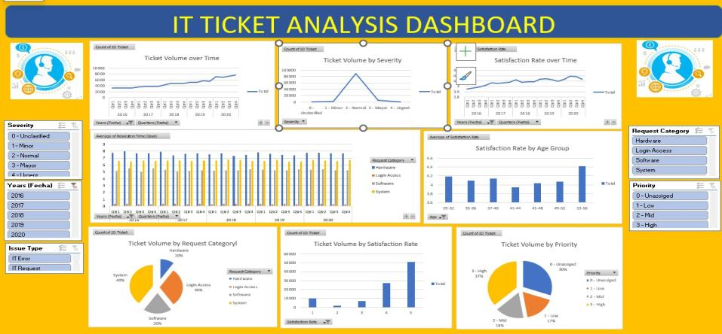

Dashboard

Slide 17


Summary of Findings
▶ Average resolution time shows moderate variation among agents, indicating differences in efficiency and workload handling.
▶ Satisfaction levels are consistently high (avg. ≈ 4.1/5), demonstrating strong overall service quality.
▶ System and Login Access issues form ~70% of all tickets — revealing key focus areas for preventive solutions.
▶ Most tickets are low-to-medium severity, but high-priority and unassigned cases need closer monitoring.
▶ Weak correlation observed between Resolution Time and Satisfaction Rate, suggesting that employee satisfaction depends more on service quality and communication than on ticket speed alone.
▶ Ticket volumes have steadily increased, showing the need for scalable support infrastructure.

Slide 18


Recommendation s
▶ Agent Training & Support: Provide coaching to agents with higher resolution times to balance team performance.
▶ Automated Ticket Routing: Implement category- and priority-based auto-assignment to minimize unassigned tickets.
▶ SLA Tracking: Strengthen monitoring of high-severity and overdue tickets to ensure timely resolution.
▶ Preventive Measures: Reduce repetitive System / Login Access issues via proactive maintenance and access-management policies.
▶ Recognition Program: Introduce a quarterly rewards system for top-
performing agents to sustain motivation.
▶ Focus on Quality of Interaction: Since satisfaction is not strongly tied to resolution speed, train agents to improve communication and problem-solving clarity.

Slide 19


